Slide 1
Data Mining Data Understanding and data mining methodology
Ehsan Mirzaei
Jun 2022

Slide 2
Standard Process of Data mining (Methodology)
Cross Industry Standard Process for Data Mining (CRISP-DM)
Sample, Explore, Modify, Model, and Assess (SEMMA)

Slide 3
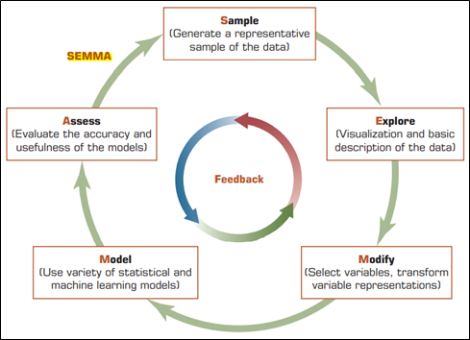
SEMMA

Slide 4

CRISP - DM
Business Understanding
Data Understanding
Data Preparation
Modeling
Evaluation
Deployment

Slide 5
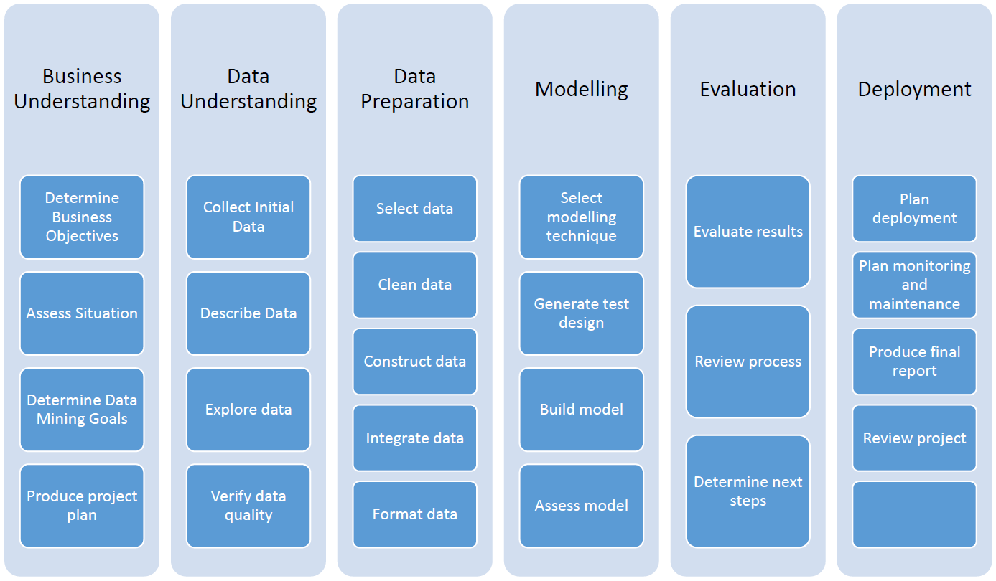
CRISP - DM

Slide 6
Data Understanding
Summary statistics
Data visualization
Exploratory data analysis

Slide 7
Data Understanding
Summary characteristics including.
how many records are available
how many variables
how many target variables
Enumerate problems with the data.
Visualize data to gain further insights into the characteristics of the data

Slide 8
Data Understanding

Slide 9
Data Understanding
Mean (μ): middle of the distribution or a typical value
Standard Deviation (): measures the spread of the distribution
Skewness: measures how balanced the distribution is
Kurtosis: measures how much thinner or fatter the distribution is compared to the normal distributions

Slide 10
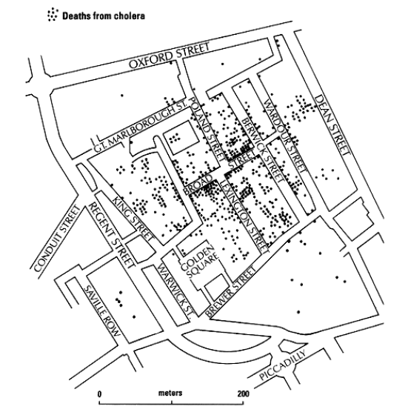
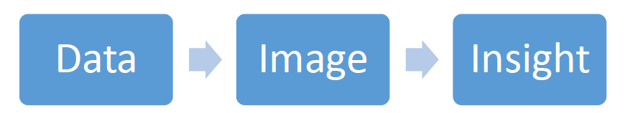
Data visualization
The process of displaying data (often in large quantities) in a meaningful fashion to provide insights that will support better decisions.
Table
Chart
Dashboard represent of a set of visualization

Slide 11
Exploratory data analysis (EDA)
examine the interrelationships among the attributes;
identify interesting subsets of the observations;
develop an idea of possible associations amongst the predictors, as well as between the predictors and the target
The Goal for EDA is_
Investigate variables
Examine Distributions of Categorical variables
Look at Histograms of numerical variables
Explore relationships among sets of variables

